Slide 1

Stock Price Movement via Machine Learning
Group: Five Star Partners

Slide 2
Objective
Our objective is to investigate in the investment opportunities though predicting the tick price movements of underlying stock (TSLA).
To be specific, we will focus on the statistical arbitrage trading strategies in market microstructures. We will apply various techniques such as constructing momentum factors, performing pair trading and training deep learning models to explore the characteristics of price movements and generate execution strategy of large order size.

Slide 3
Pipeline
Fetch Trade & Quote data
Generate features and labels
Predict next up and down
Application
VWAP comparison of buy and sell
Market making with model prediction

Slide 4
Data Summary
Input
"1/1/2019“ to "1/31/2019“ tick data from WRDS
"trade_size", "pct_change", "direction” of previous 50 ticks
150 features for each sample
Output
Direction of change of the average of the next 10 following prices
classification of up, down and same (<1e-3)

Slide 5
Model summary
Base model
Tick factor introduced in class
Machine learning models
LSTM
CNN
Random Forest
Gradient Boost
XGBOOST

Slide 6
1
Ups and Downs
Prediction

Slide 7
Data Summary
Train date (10 days)
'20190102', '20190103', '20190104', '20190107', '20190108', '20190109', '20190110', '20190111', '20190114', '20190115’
Test date (10 days)
'20190117', '20190118', '20190122', '20190123', '20190124', '20190125', '20190128', '20190129', '20190130', '20190131’
Class percentage
positive 0.4660815626237297
neutral 0.057146627953015706
negative 0.4767718094232546

Slide 8
1 LSTM
hidden_dim = 30
n_epochs = 100
batch_size = 128
activation = "tanh"
loss = 'categorical_crossentropy'
stop_patience=20

Slide 9
2 CNN
hidden_dim = 30
n_epochs = 100
batch_size = 128
activation = "relu"
loss = 'categorical_crossentropy'
stop_patience=20

Slide 10
3 Random Forest
max_depth=30
n_estimators=100
max_features=0.3
criterion = 'gini'

Slide 11
4 Gradient Boost
n_estimators=30
max_depth=30
learning_rate=0.05

Slide 12
5 XGBOOST
n_estimators=30
max_depth=30
learning_rate=0.05
reg_lambda=0.1

Slide 13
Comparison

Slide 14
2
Application 1
VWAP of buy and sell

Slide 15
General setting
VWAP coefficients
[ 9.95503275e-03, -1.01533564e-04, 5.73879785e-07,
-1.47027197e-09, 1.38993793e-12]
round_lot = 1
VWAP price is penalized for last min order
last_min_penalty = 100
Four cases for different schedule and model coefficients
Performance evaluation
P&L
Last minute order size

Slide 16
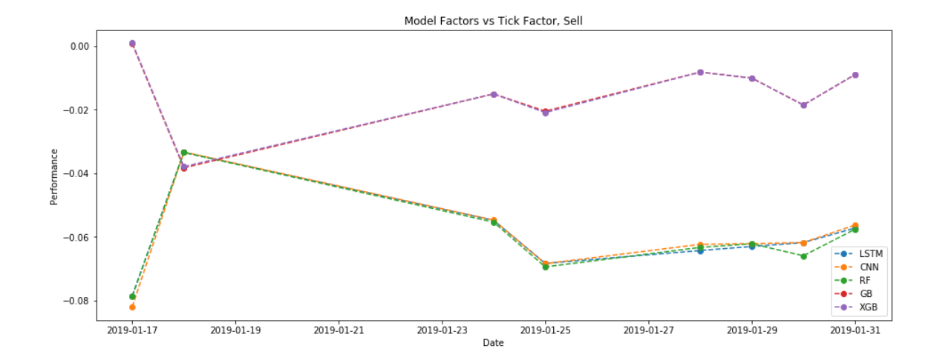
Case 1 model_coef = 1.0 schedule_coef (sell) = -0.5

Slide 17
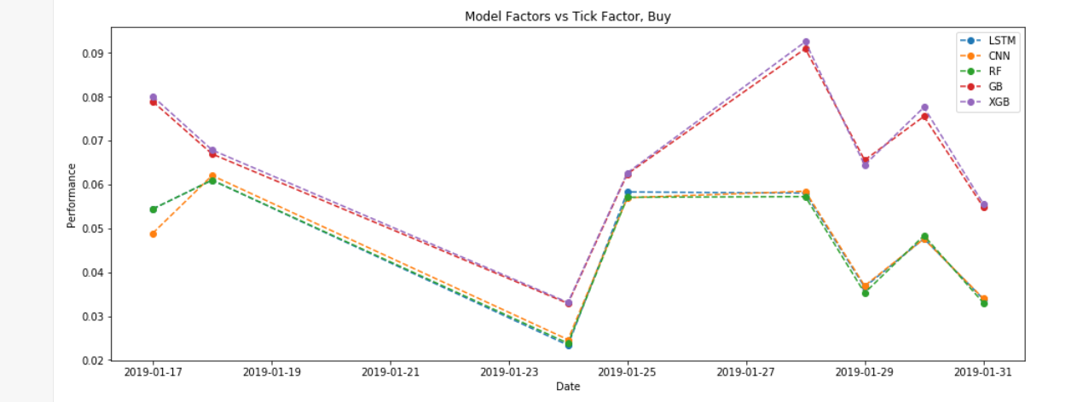
Case 1 model_coef = 1.0 schedule_coef (buy) = 0.5

Slide 18
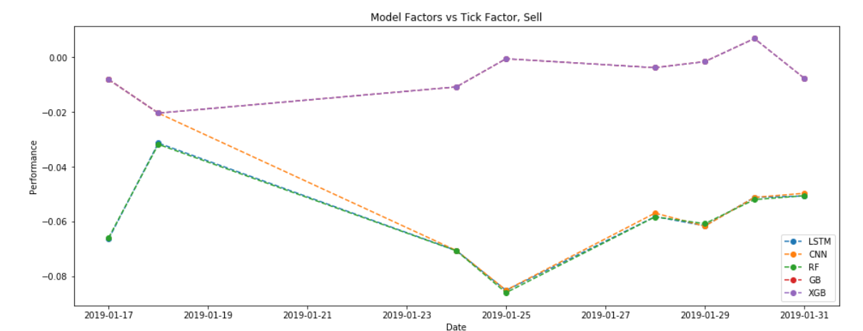
Case 2 model_coef = 1.0 schedule_coef (sell) = -1.0

Slide 19
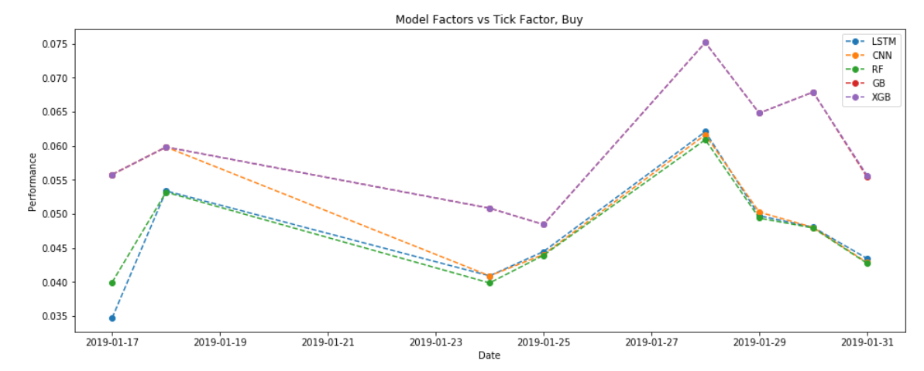
Case 2 model_coef = 1.0 schedule_coef (buy) = 1.0

Slide 20
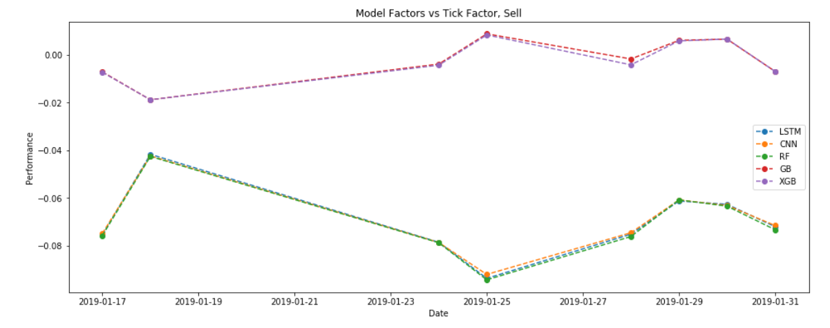
Case 3 model_coef = 2.0 schedule_coef (sell) = -1.0

Slide 21
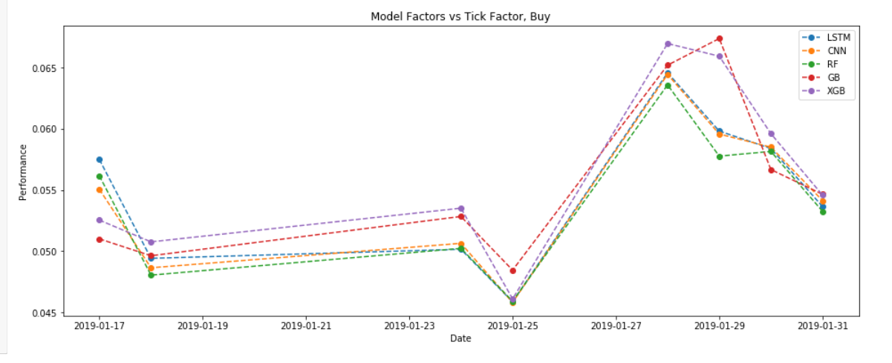
Case 3 model_coef = 2.0 schedule_coef (buy) = 1.0

Slide 22
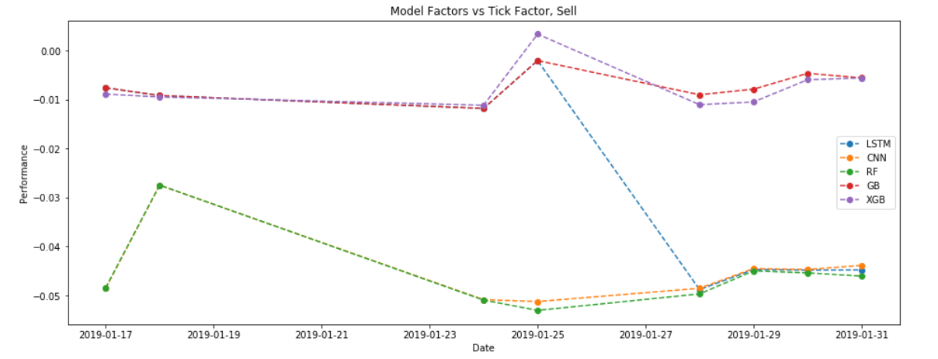
Case 4 model_coef = 1.0 schedule_coef (sell) = -2.0

Slide 23
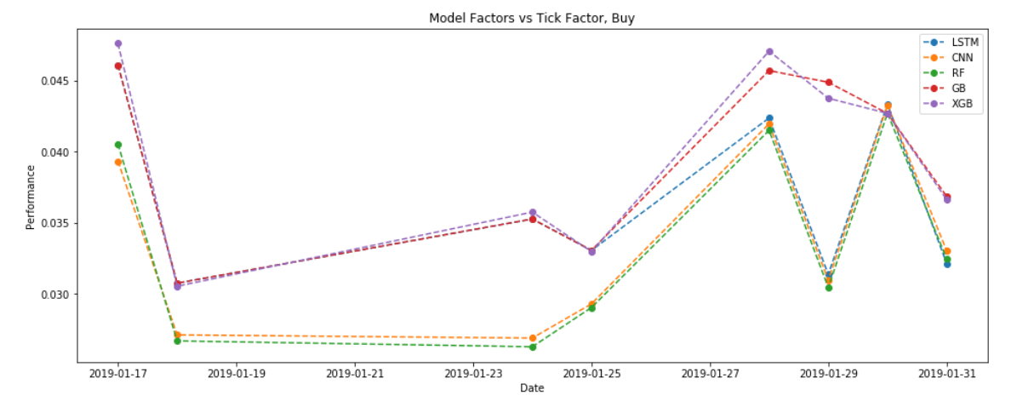
Case 4 model_coef = 1.0 schedule_coef (buy) = 2.0

Slide 24
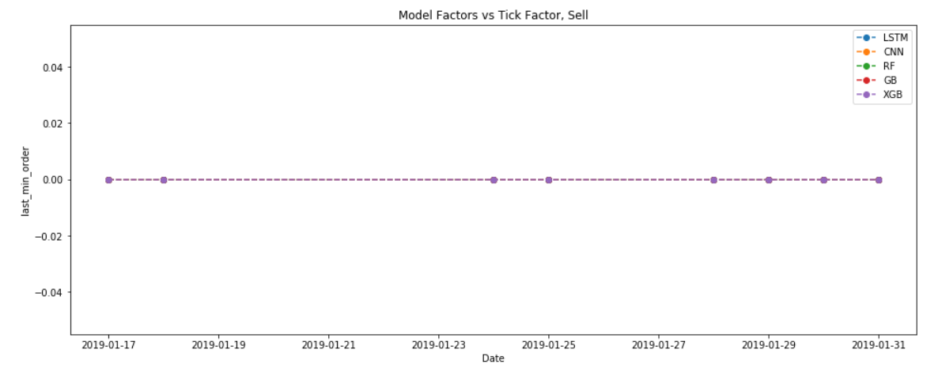
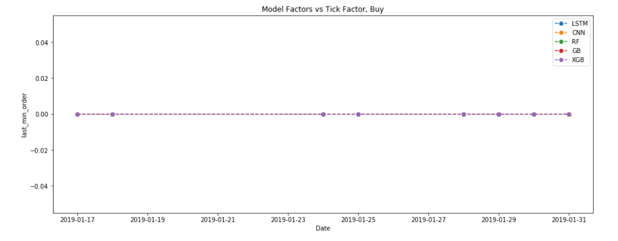
Last Minute Order

Slide 25
3
Application 2
Market Making

Slide 26
General setting
factor coefficients
tick_coef: 0.2, 0,5, 1.0, 2.0
risk_coef=1.0
model_coef : 0.2, 0,5, 1.0, 2.0
Dollar amount for maximum position: 5000000
Performance evaluation
P&L
Last order size

Slide 27
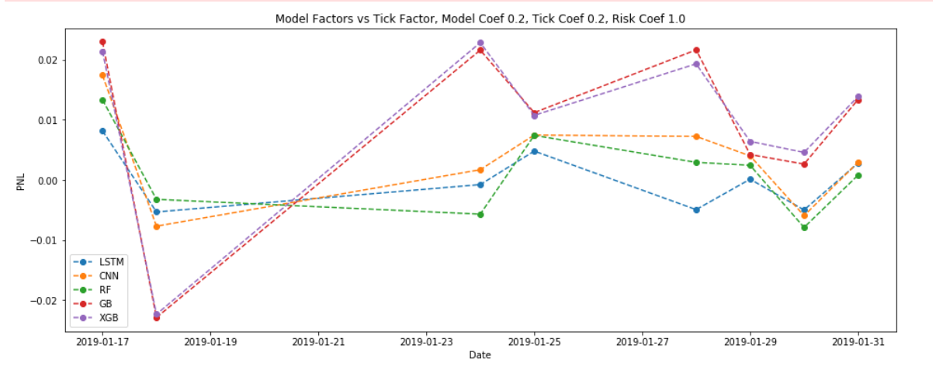
Case 1 (P&L) model_coef = 0.2

Slide 28
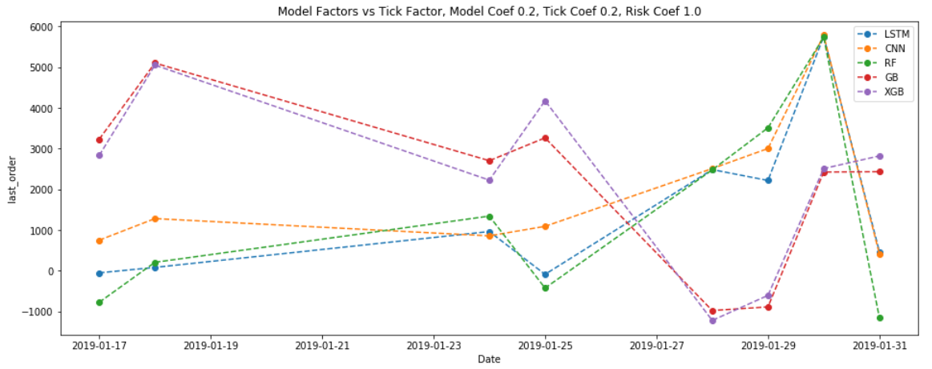
Case 1 (last order) model_coef = 0.2

Slide 29
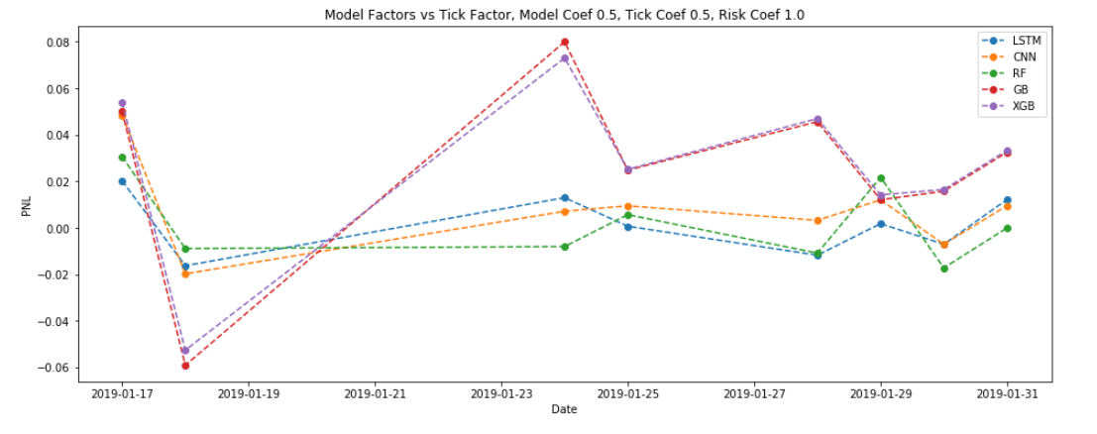
Case 2 (P&L) model_coef = 0.5

Slide 30
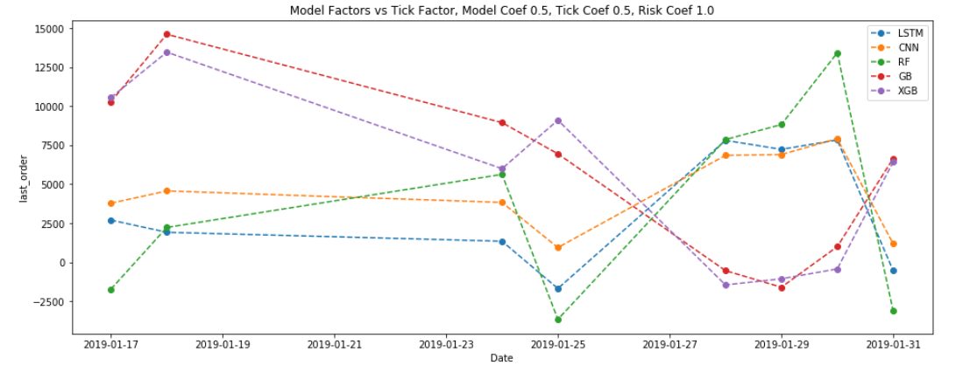
Case 2 (last order) model_coef = 0.5

Slide 31
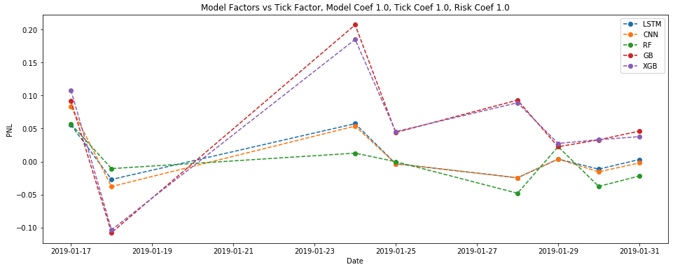
Case 3 (P&L) model_coef = 1.0

Slide 32
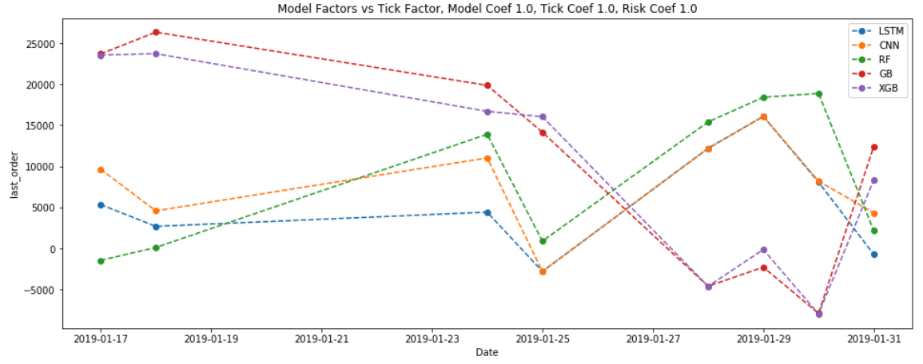
Case 3 (last order) model_coef = 1.0

Slide 33
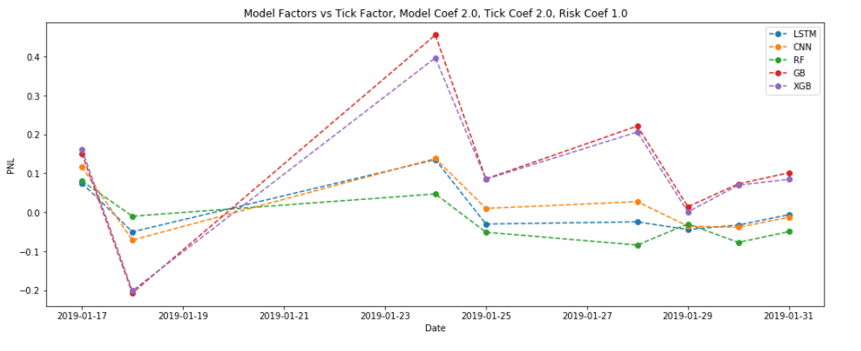
Case 4 (P&L) model_coef = 2.0

Slide 34
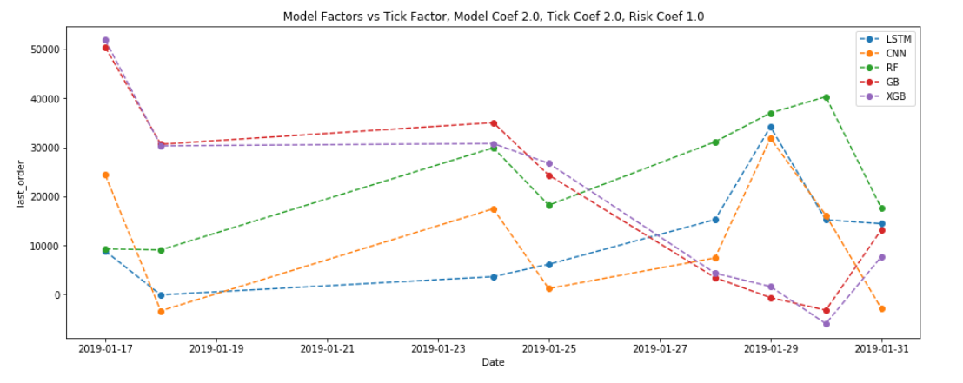
Case 4 (last order) model_coef = 2.0

Slide 35
4
Conclusion
&
Improvements

Slide 36
Conclusion
From the perspective of prediction accuracy, we see that there is a significant improvement of machine learning methods over the tick factor in the domain of high-frequency trading.
For the VWAP applications, we have obtained slightly better results than the tick factor. It worth to notice that the main goal of VWAP is to timely execute orders, rather than to make money.
For the market making applications, we have accomplished better results over tick factors with respect to P&L. Our experimental results show that machine learning methods are promising in the area of high-frequency trading.

Slide 37
Limitations
Due to the limitation of computation power, we are not able to train and test models in a large scale.

Slide 38
Future Work
More complicate machine learning models could be applied to exploit the dynamics of high frequency trading, for example, deep neural networks with complicate structures.
More experiments should be done, with larger training and testing sample size.

